Slide 1


SuperStore Sales Analysis
DATA ANALYSIS PROJECT
PREPARED BY:
Rishikesh Singh

Slide 2
CONTENTS
Problem Statement
Gathering & Cleaning Data
Exploring The Data
Assumptions
Research Questions
Formulating Hypothesis
Testing All 5 Hypothesis
Conclusion
Suggestions
Challenges & Learnings

Slide 3
1.
PROBLEM STATEMENT
Let’s start with a brief description of the problem statement

Slide 4
Problem Statement:
The Superstore dataset provides sales and profit data for a variety of products across different categories and regions.
The goal of this project is to analyze this data and identify insights that can help the company improve its business performance in future.
Specifically, we aim to answer questions such as: which product categories are the most profitable? Which regions have the highest sales and profit? What are the most profitable products?
By answering such questions, our aim is to provide suggestions for the company on how to improve its revenue and profitability.

Slide 5
2.
GATHERING & CLEANING DATA
Gathering and cleaning of dataset

Slide 6
Gathering & Cleaning Data:
Now we have defined the problem statement so now our task is to gather the data and then to clean it.
This could involve collecting data from various sources or accessing existing data sets. The need to clean the data is to ensure that it's accurate, complete, and consistent.
The Superstore Dataset which is used in this project has been collected from Kaggle.

Slide 7
3.
EXPLORING THE DATA
EDA performed on the dataset to explore the data

Slide 8
Exploratory Data Analysis
Once the data that we have gathered is cleaned, we need to explore the data in order understand the data to get a sense of what it contains.
This process is known as Exploratory Data Analysis. It was performed in python jupyter notebook.
This might involve creating visualizations, calculating basic statistics, or conducting other exploratory analysis techniques.

Slide 9
4.
ASSUMPTIONS
Assumptions made

Slide 10
Assumptions
The superstore dataset contains a representative sample of all transactions conducted by the store during the time period covered by the dataset which is from 2011 to 2015.
The data in the superstore dataset is accurate and has been cleaned and preprocessed prior to analysis.
The superstore dataset covers a sufficient time period to allow for the identification of trends or patterns in sales and profitability.
The Super Store dataset is not impacted by any significant outliers or anomalies that could skew the results of any analysis conducted on the dataset.

Slide 11
5.
SOME RESEARCH QUESTIONS
Some research questions to help understanding the problem statement

Slide 12
Research Questions
We’re interested in understanding which factors contribute to high sales in the superstore.
Which product categories have the highest profit margins in the Super Store?
Are there any significant differences in sales between the East region and other regions?
How do sales vary by product category during different months of the year?
What is the rate of returned products for orders with same-day shipping compared to other shipping options?
How do sales and profit vary by product category on weekdays compared to weekends?

Slide 13
6. FORMULATING HYPOTHESES
Formulating Hypothesis to guide the project's goals and objectives
13

Slide 14
Formulate Hypothesis
Hypothesis 1: Technology products have the highest profit margin compared to other product categories.
Hypothesis 2: The East region has the highest sales compared to other regions.
Hypothesis 3: Sales are higher during certain months of the year.
Hypothesis 4: Orders with same-day shipping have the lowest rate of returned products.
Hypothesis 5: The company's profit is more on weekdays than on weekends.

Slide 15
7. TESTING ALL 5 HYPOTHESES
Testing whether these Hypothesis are supported by the evidence or not.
15

Slide 16
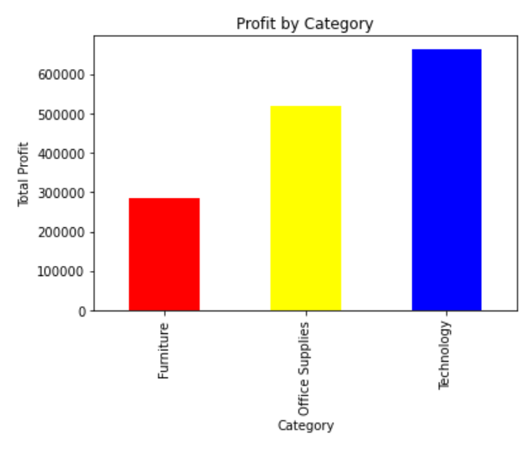
Testing The Hypothesis: 1
Hypothesis 1: Technology products have the highest profit margin compared to other product categories.
The Hypothesis is supported as technology products have the highest profit margin of the three categories.

Slide 17
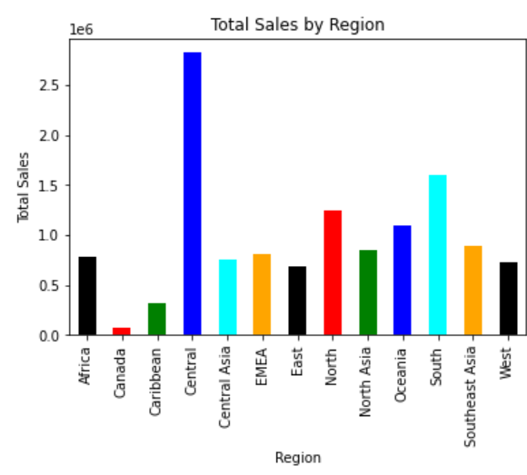
Testing The Hypothesis: 2
Hypothesis 2: The East region has the highest sales compared to other regions.
The hypothesis is not supported as the Central region has the highest sales

Slide 18
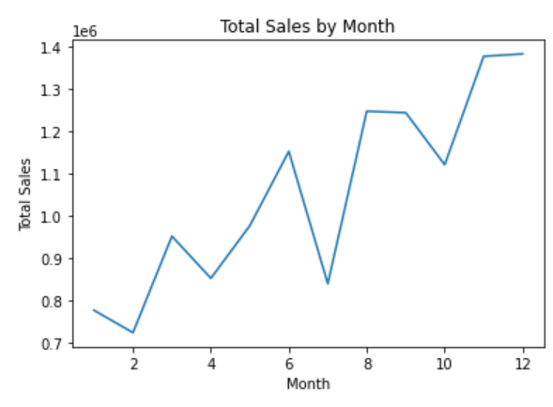
Testing The Hypothesis: 3
Hypothesis 3: Sales are higher during certain months of the year.
Sales are higher in November and December.
This supports our hypothesis that sales are higher during certain months of the year.

Slide 19
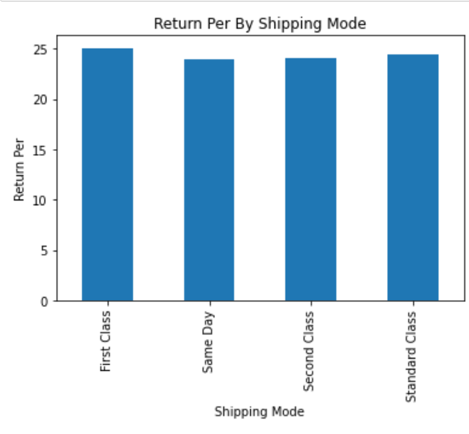
Testing The Hypothesis: 4
Hypothesis 4: Orders with same-day shipping have the lowest rate of returned products.
The hypothesis is supported as orders with same-day shipping have the lowest rate of returned products.

Slide 20
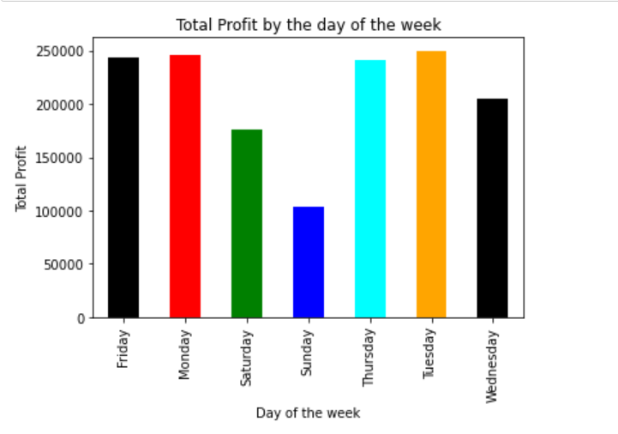
Testing The Hypothesis: 5
Hypothesis 5: The Company's profit is more on weekdays than on weekends.
The hypothesis is supported as the company's profit is higher on weekdays compared to weekends.

Slide 21
8. CONCLUSION
Final Conclusion about the formulated hypothesis
21

Slide 22
AT THE END…
The analysis reveals that when compared to other products, technology-based products have the highest profit margin.
During weekdays, the company's profit is observed to be higher than on weekends. Moreover, sales tend to increase in specific months of the year.
The analysis demonstrates that orders with same-day shipping have the lowest rate of returned products. However, the data does not support the hypothesis that the East region has higher sales than other regions.
These findings offer valuable insights into the company's performance and may serve as a guide for future decision-making.
It should be acknowledged that additional research may be necessary to fully comprehend the underlying factors that influence these observations.

Slide 23
9. SUGGESTIONS
Suggestions to optimize its product offerings and improve its revenue and profitability
23

Slide 24
Suggestions to Improve It’s Revenue
To increase its profits, the company should prioritize the development and promotion of technology products, while reducing the production and marketing of products with lower profit margins.
The highest sales are observed in the Central region, and the company could focus more on this area. Furthermore, the company should reassess its sales and marketing strategies in other regions.
Maximizing sales during November and December should be a key focus for the company. This could be achieved by increasing the stock of popular products during this period, launching targeted marketing campaigns, and offering promotions or discounts to customers. However, the company should also explore methods to maintain sales during slower months, such as introducing new products or services or providing incentives to customers through promotions and discounts.

Slide 25
Suggestions To Improve It’s Revenue & Profitability
To provide better service to customers, the company could explore the possibility of increasing its same-day shipping options. This might require optimizing the inventory and supply chain processes to ensure quick and efficient shipping of products.
To enhance weekend sales, the company could concentrate on various kinds of promotions or sales strategies. For instance, the company could offer weekend-specific promotions or discounts or launch targeted marketing campaigns to attract weekend shoppers. In-store special events or activities during weekends could also be an option to attract customers and boost sales. Furthermore, the company could focus on offering products and services that are popular among weekend shoppers, such as home entertainment or outdoor products.

Slide 26
10. CHALLENGES & LEARNINGS
Challenges faced & Learning had from this project
26

Slide 27
Challenges & Learnings
Challenges:
Visual Representation of Data
Coming up with Suggestions
Learnings:
Cleaning the Dataset
Performing EDA on the Dataset
Formulating Hypothesis and testing them

Slide 28
THANK YOU! Any Questions?

